Slide 1
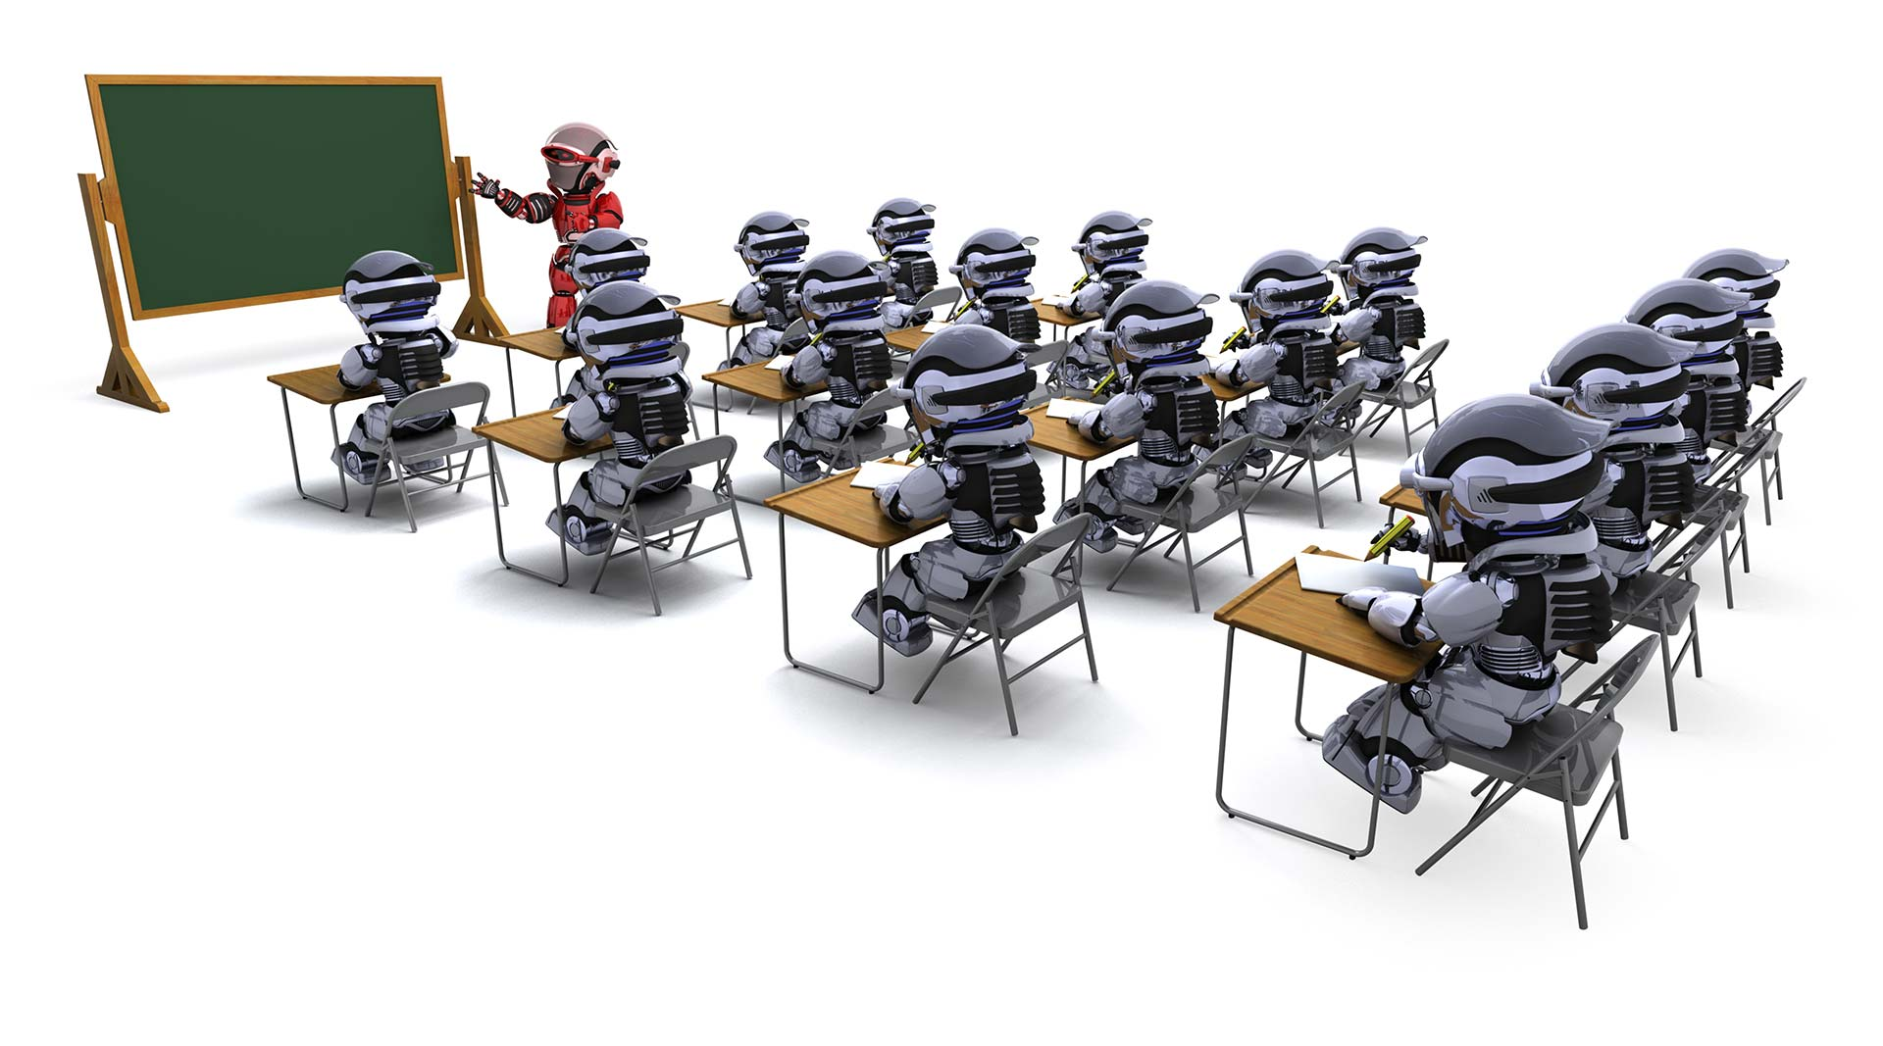
ROBOTICS WORKSHOP

Slide 2
INTRODUCTION
WHAT IS ROBOTICS ???????
ROBOTICS FOR SCHOOL STUDENTS
WORKSHOPS
Certificate Distribution

Slide 3
INTRODUCTION
This workshop will provide school students a base to robotics for kids .
They will learn to control the robots using normal electrical concepts.
The workshop focuses on application and use of technology .
The duration of this workshop will be 2-3 consecutive days

Slide 4

WHAT IS ROBOTICS……???????

Slide 5
Robotics is an interdisciplinary branch of engineering and science that includes mechanical engineering, electrical engineering, computer science, and others.
The concept of creating machines that can operate autonomously.

Slide 6
ROBOTICS FOR SCHOOL STUDENTS
Student Robotics is a volunteer based program.
Consists of programming concepts.
For global representation of schools/colleges.
Enhances creativity and it kind of school extra cirriculum activities.

Slide 7
WORKSHOPS
It’s a 2-3 day workshop program
Students will be given special training to interface hardwares and softwares.
Learning about sensors and basic hardwares.

Slide 8
Workshop(Day-1)
Introduction to softwares and hardwares.
Basic programming skills
Basic hardware installations.
Assembling sensors with programs and softwares.

Slide 9
Workshop(Day-2)
Developing programs
Building real digital gadgets .
Simple programming competition.
Students feedback.
Certificate Distribution.

Slide 10
Thank you

